Slide 1
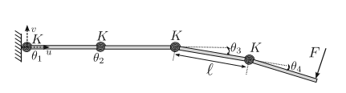
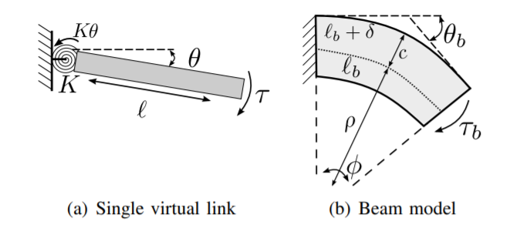
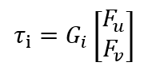
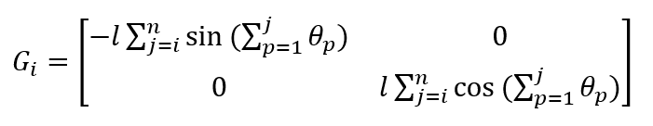
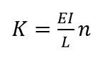

Dynamical Modeling
Torque:
Stiffness:

Slide 2
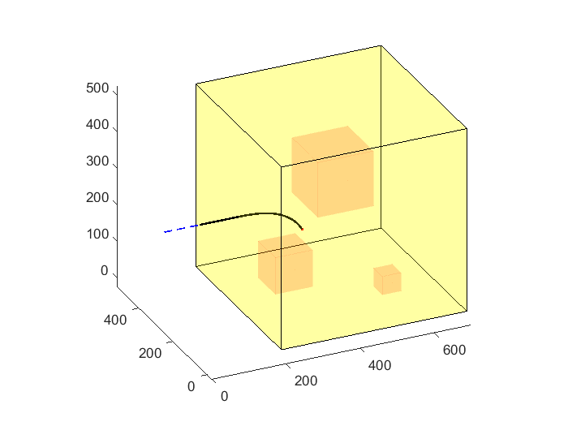
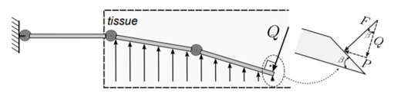
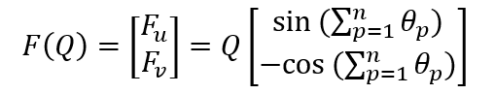
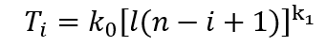
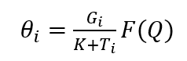
Dynamical Modeling
Reaction Force:

Slide 3
Trajectory Planning
Based on Rapidly-exploring random tree star (RRT*) Algorithm
Sample N points inside non-obstacle area in the tissue.
Find nearest neighbors for each new point in present point.
For each point in the nearest neighbors, detect whether the line from the new point to this point collided the obstacles. If not, calculate the total cost of trajectory for the new point moving from the start point by this point.
Then find the nearest neighbor with the lowest cost and then set it as the father node of the new point.
After all points sampled, find the shortest trajectory from the start point to the target point by each node.

Slide 4
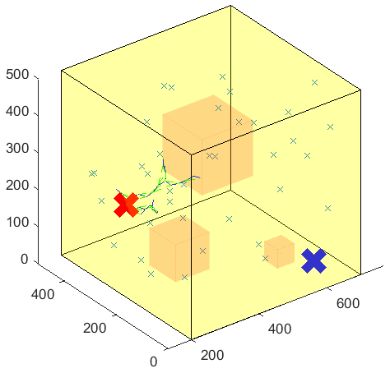
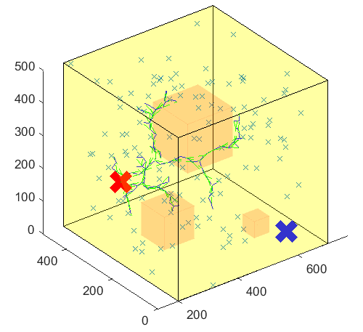
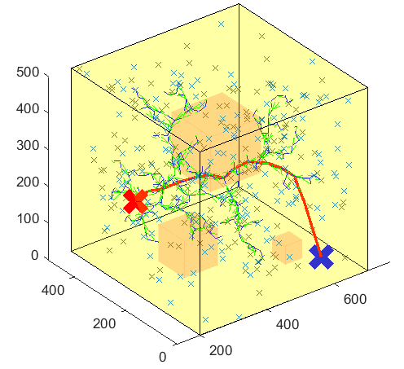
Trajectory Planning
Traj (mm) =
200.0000 250.0000 250.0000, 230.1215 253.8357 256.2868, 274.2680 260.5723 244.1910,
308.0935 261.8277 225.6793, 329.1909 263.4734 197.8473, 360.6600 247.0416 187.7064,
396.1142 255.0453 181.1035, 415.5376 228.3491 165.6633, 433.4836 197.3041 151.8807,
454.3187 168.9955 166.9790, 481.5936 164.7785 188.4427, 504.2327 139.0109 206.5661,
544.0905 120.0427 204.1567, 565.6334 100.7231 192.4548, 600.0000 50.0000 50.0000

